Slide 1
Gaussian Blur
Mold Florian, Karakaya Aytac

Slide 2
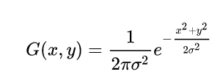
Problem explanation
Gaussian function in two dimensions:
A Gaussian blur is the result of blurring an image by a Gaussian function.
It is a widely used effect in graphics software, typically to reduce image noise and reduce detail.
The Gaussian blur is a type of image-blurring filter that uses a Gaussian for calculating the transformation to apply to each pixel in the image.
The Gaussian outputs a ‘weighted average’ of each pixel's neighborhood, with the average weighted more towards the value of the central pixels.
The original pixel's value receives the heaviest weight (having the highest Gaussian value) and neighboring pixels receive smaller weights as their distance to the original pixel increases.
Parameters:
Sigma: This defines how much blur there is. A larger number is a higher amount of blur.
Radius: The size of the kernel in pixels

Slide 3
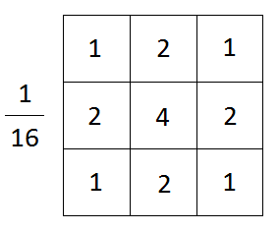
Workload
The xl.bmp image has a resolution of 2000px x 2000px which has 4.000.000 pixels in total. This results in 1.760.000.000 total iterations that need to be made to calculate the blurred image with a radius of 10.
This huge amount of workload comes from computing the kernel for every pixel.
Example kernel:

Slide 4
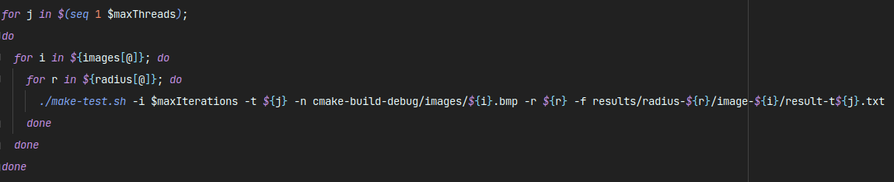
Environment
Technology: C++, OpenMP
8 Core CPU
16GB RAM
Shell script for executing the program and collecting the runtimes of the program into a .csv file.
For all measurements, the program was executed 30 times and the mean of the execution times was taken for the calculations.
We only measured calculating the values of the pixels. Not the reading/writing of the image to the disk.

Slide 5
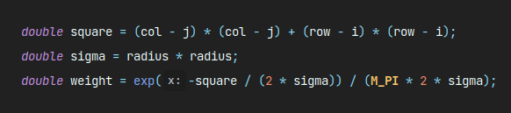
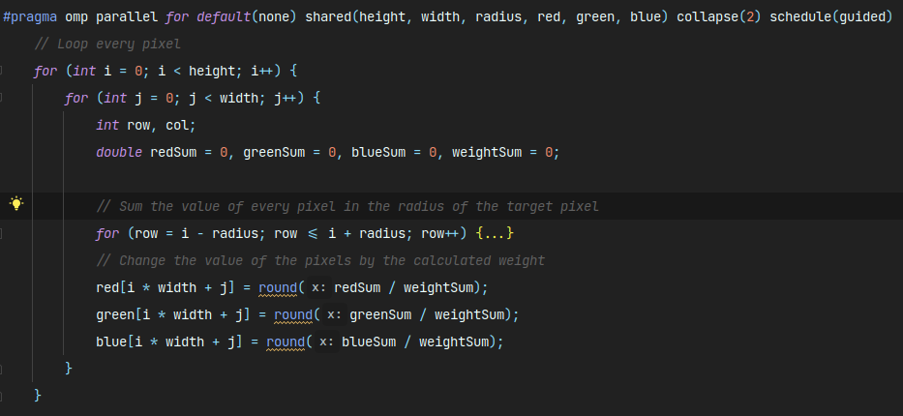
Parallelized Part
Gaussian function in two dimensions:

Slide 6
Approach
The two nested loops which compute the new blurred value of every pixel can be executed in parallel.
Every iteration of the loop is independent from the previous iteration, so the work can be distributed evenly for every thread.
We chose schedule(guided), because not every thread has the same amount of work. Pixels at the edge of the image do not have to calculate a kernel that is as large as a kernel in the center of the image.
The two nested loops can be collapsed, because the loops are independent from each other.
We went for data parallelism, because the computation for every pixel is the same and it can be easily parallelized with a for loop.

Slide 7
Problems
We tried to parallelize the inner loops, which calculate the kernel for every pixel.
But this slowed down the program, because every thread of the outer loop spawn's new threads for the inner loop, which must wait at the end of the parallel for section, because there is an implicit barrier. We used reductions, so that every thread has its own copy of redSum, greenSum, blueSum and weightSum.
We do not know the specific reason, why the program performed slightly worse, we think oversubscription happens.

Slide 8
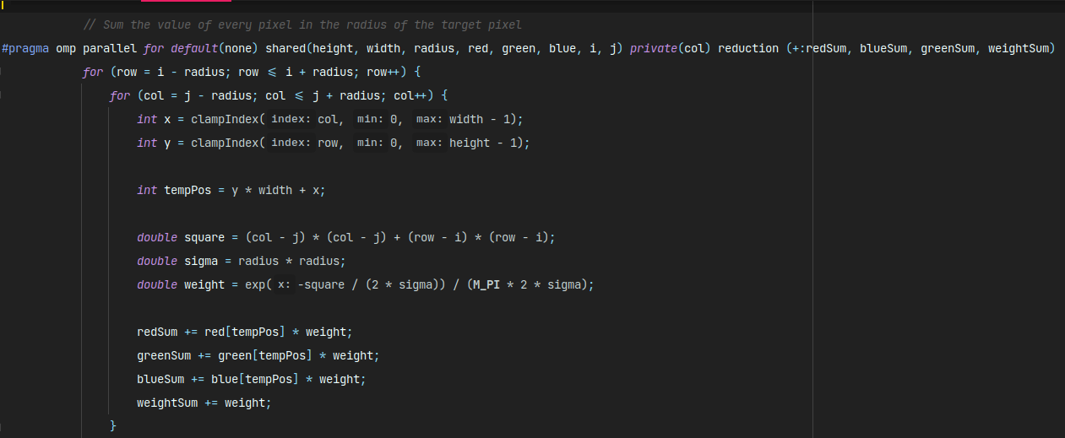
Problems

Slide 9

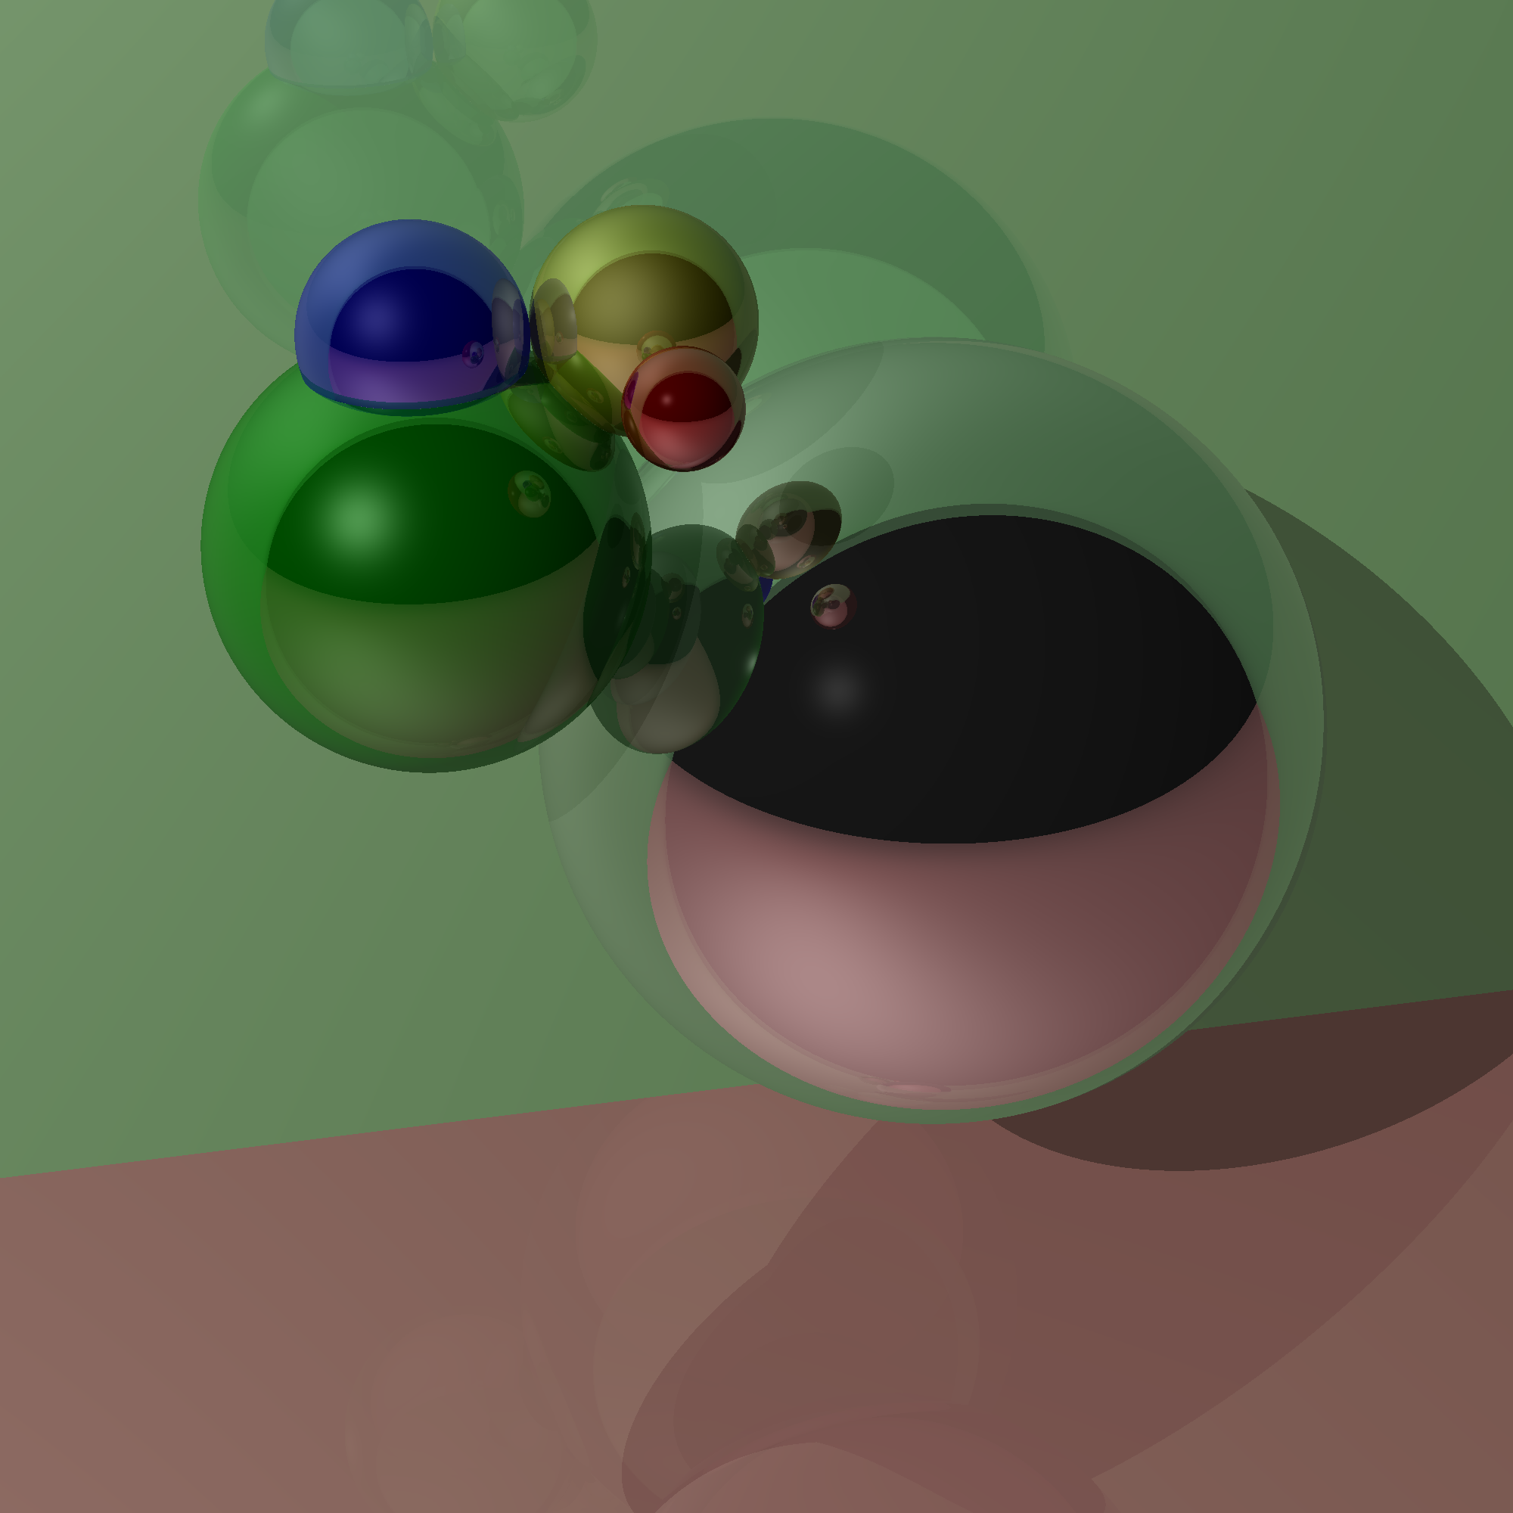
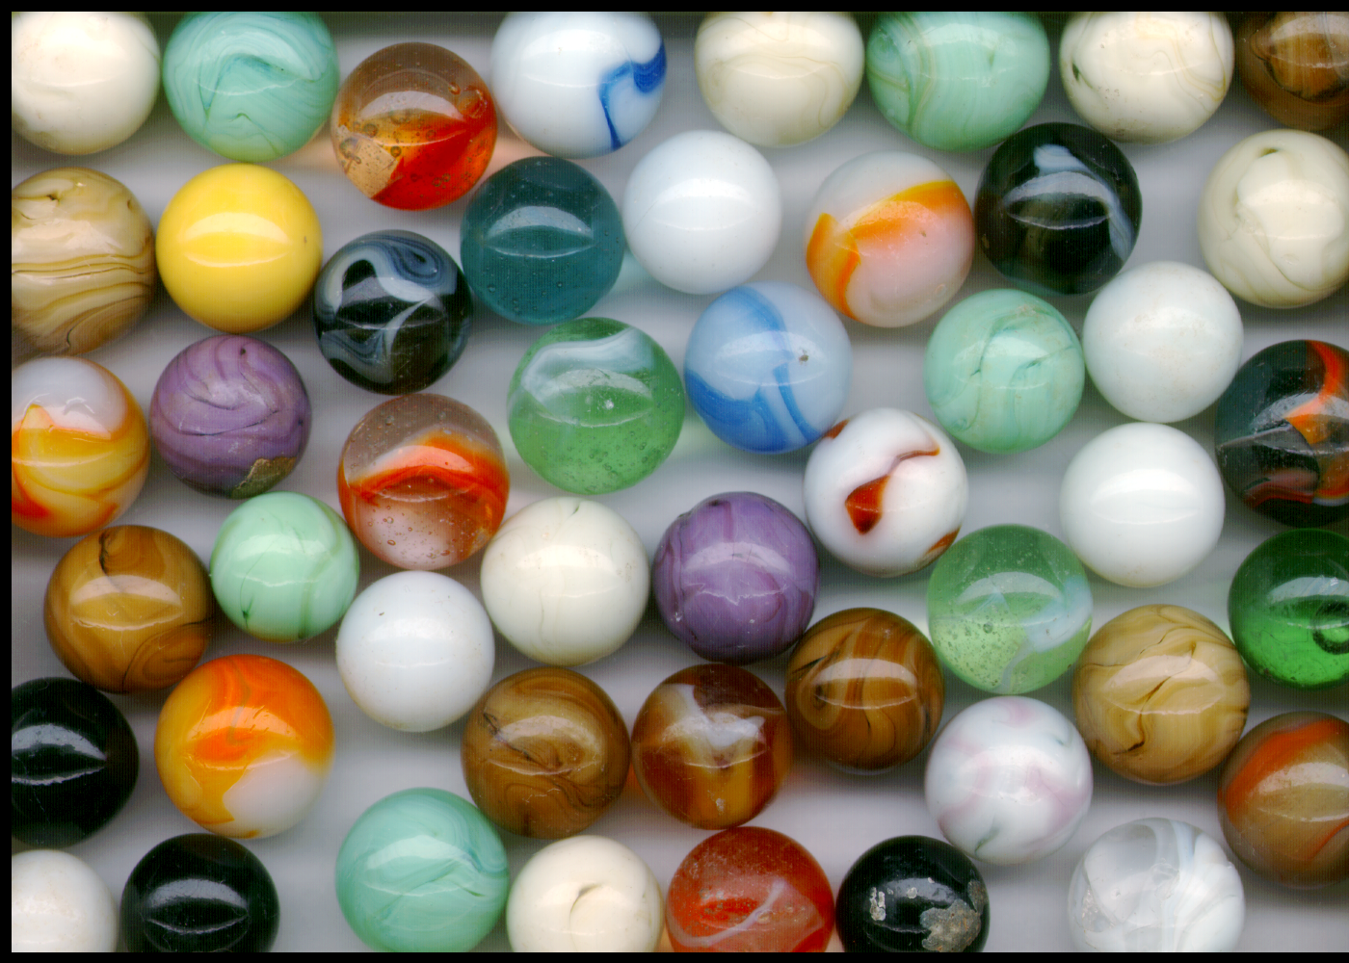

Test images
Small image: delta.bmp
800px x 600px
Large image: xl.bmp
2000px x 2000px
Medium Image: balls.bmp
1400px x 1000px
Medium image: mandelbrot.bmp
1920px x 1080px

Slide 10



Results
Large Image (2000px x 2000px)
radius 1, xl.bmp
radius 5, xl.bmp
radius 10, xl.bmp

Slide 11



Results
Medium Image (1920px x 1080px)
radius 10, mandelbrot.bmp
radius 1, mandelbrot.bmp
radius 5, mandelbrot.bmp

Slide 12
Speedup: Large Image
Large Image: xl.bmp, radius 4

Slide 13
Speedup: Large Image
Large Image: xl.bmp, radius 10

Slide 14
Speedup: Medium Image
Medium Image: balls.bmp, radius 4

Slide 15
Speedup: Medium Image
Medium Image: balls.bmp, radius 10

Slide 16
Overall Speedup

Slide 17
Overall Speedup

Slide 18
Conclusion
At first our expected speedup with 8 threads was 6. This expectation was due to having many nested loops, which couldn’t be parallelized quite well.
For high radius values and large images, we got a speedup of about 7, which is very good.
Lower radius values seem to have not as much speedup. Maybe the workload is too small for the number of threads. For smaller images, the speedup seems to stagnate with 8 threads.
Lower radiuses seem to have a problem speeding up the program, because the speedup plummets sometimes with a higher threadcount.
Overall, our speedup exceeded our expectations, with the highest average speedup we achieved being ~7,18.

